Slide 1



Hardware and Software Fundamentals of Intelligent Computing Systems

Slide 2
Lecture 25：Multi-end Support I （Codegen）

Slide 3
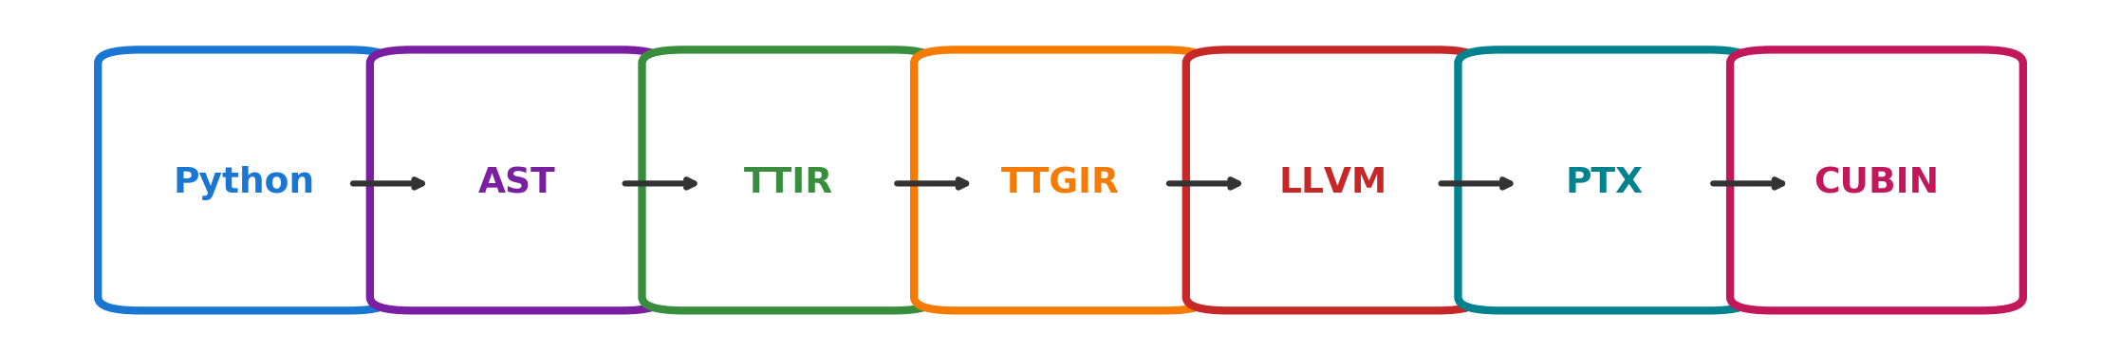
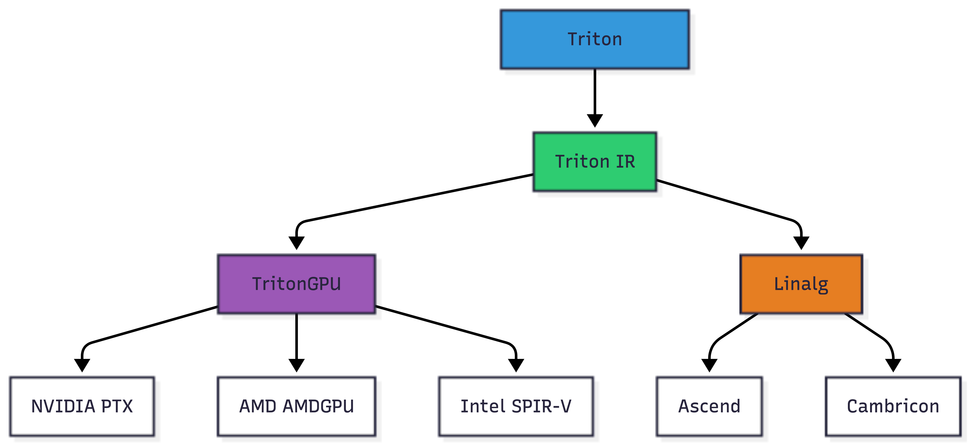
Multi-end Compilation Flow
Triton Compilation Flow
Multi-end Support in Triton
Compiler Backend：IR->Machine Code
Adapting to different target architectures
Generating efficient target code
Leveraging hardware features
Main Pipeline
Instruction Selection
Register Allocation
Instruction Scheduling
Code Emission
Fragmentation of AI Computing Hardware
The same algorithm requires generating different code for different hardware targets

Slide 4
Instruction Selection
The process of translating IR into target machine instructions
A single IR instruction may correspond to multiple machine instruction combinations
Selecting the optimal instruction sequence
Tree Covering Algorithm
Cover the entire tree with the fewest and fastest instructions
Dynamic Programming
Cost Model:
Cost(node) = min over all matching patterns {pattern_cost + Σ Cost(children not covered)}
Calculate Optimal Coverage Bottom-Up
SelectionDAG Matching in LLVM
Define patterns using TableGen
Automatically generate matching code
Support complex instruction fusion
IR Tree: Machine Code:
add
/ \ add r1, r2, r3
load mul add r1, r2, imm
| / \ madd r1,r2,r3,r4
ptr a b ld.add r1, [ptr]

Slide 5
Register Allocation
Inifinite Virtual Register → Finite Physical Registers
Variables that are live simultaneously cannot share a register
Interference Graph
Nodes = Variables
Edges = Simultaneously live (conflicting)
Graph Coloring Algorithm
Input: Interference graph G, k physical registers
Goal: k-coloring (adjacent nodes get different colors)
Chaitin's Algorithm:
Remove nodes with degree < k onto the stack
If all nodes have degree >= k, select one to spill to memory
Pop stack and assign colors
Insert load/store to handle spills
Linear Scan: O(n) complexity, commonly used in JIT compilation
PBQP: Partitioned Boolean Quadratic Programming
a: ████████
b: ████████████
c: ████
d: ████████
e: ████
a ─── b ─── c
│ │
d ─── e

Slide 6
Register Allocation-GPU Cases
Unique Characteristics of GPU Register Allocation
More registers (fewer warps)
Fewer spills
May reduce parallelism; all data has zero latency
Latency cannot be hidden
Triton Register Allocation
Indirectly controls register pressure via num_warps
Configuration Tradeoffs
64 registers per thread, Occupancy 50%
No spills, sufficient warps to hide latency, good performance
32 registers per thread, Occupancy 100%
Some data spills to Local Memory; although more warps, the spill penalty is large, poor performance
200 registers per thread, Occupancy 15%
No spills, but too few warps to hide memory latency, poor performance
Feature | CPU | GPU
Register Size | ~16-32 | ~255 per thread
Parallelism | Small | Thousands
Overflow Cost | Low | High
Occupation | No harm | Direct Influence
def kernel(...): # Many warps → each warp has fewer register → High Occupancy
kernel[grid](... , num_warps=8)

Slide 7
Instruction Scheduling
Minimize execution time
Hide latency
Exploit Instruction-Level Parallelism (ILP)
Instruction Sequence:
1: r1 = load [ptr1] Delay: 300 cycles
2: r2 = load [ptr2] Delay: 300 cycles
3: r3 = r1 + r2 depend on 1, 2
4: r4 = r3 * 2 depend on 3
5: store [ptr3], r4 depend on 4
Dependency graph:
load1 (300) load2 (300)
\ /
add (4)
|
mul (4)
|
store
Scheduling Result (2-issue):
Cycle 0: load1, load2 (parallel)
Cycle 300: add (wait load)
Cycle 304: mul
Cycle 308: store

Slide 8
Instruction Scheduling
List Scheduling
Priority Queue Scheduling
Compute the priority of each instruction (critical path length)
Maintain a ready queue (dependencies satisfied)
Each cycle, select the highest-priority ready instruction to issue
Update dependency state
Software Pipelining
Overlap instruction execution from different iterations within a loop.
Software Pipelining Implementation on GPU
Triton uses the num_stages parameter to control pipelining
Asynchronous memory copy (cp.async)
Hopper TMA natively supports multi-stage pipelining
@triton.jit
def matmul_kernel(...):
# num_stages control pipeline depth
for k in range(0, K, BLOCK_K):
# Stage 1: Prefetch next tile
tl.load(A_ptr_next, ...) # asynchrous
# Stage 2: Compute current tile
acc = tl.dot(a, b, acc)
# Hidden pipeline: load and compute
┌──────────────────────────────────────────────────┐
│ Iter │Stage1(Load)│Stage2(Compute)│Stage3(Store) │
├──────┼────────────┼───────────────┼──────────────┤
│ T=0 │ load[0] │ │ │
│ T=1 │ load[1] │ compute[0] │ │
│ T=2 │ load[2] │ compute[1] │ store[0] │
│ T=3 │ load[3] │ compute[2] │ store[1] │
│ ... │ ... │ ... │ ... │
└──────────────────────────────────────────────────┘

Slide 9
LLVM Code Generation Framework
LLVM IR -> SelectionDAG -> Machine IR (MIR) -> MC Layer
LLVM
IR
SelectionDAG
1. DAG Construction (Build DAG)
2. Type Legalization
3. Operation Legalization
4. DAG Optimization (DAG Combine)
5. Instruction Selection
6. Scheduling
Machine IR (MIR)
Machine Instructions in SSA Form
Register Allocation
Prologue/Epilogue Insertion
Late Machine Code Optimization
Assembly Emission
Object File Generation

Slide 10
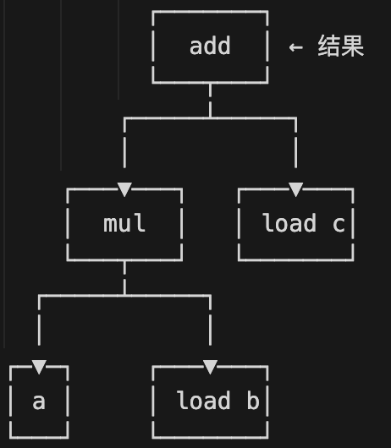
SelectionDAG
Node Types
Opcode: ADD, MUL, LOAD, STORE, ...
Value Type: i32, f32, v4f32, ...
Operand Chain: Dependency relationships
Debug Information
Type Legalization (when the target machine does not support certain types)
Original: add i128 %a, %b
Legalized (split into two i64s):
%lo = add i64 %a.lo, %b.lo
%carry = ...
%hi = add i64 %a.hi, %b.hi
%hi = add i64 %hi, %carry

Slide 11
Machine IR and Target Description
MIR Stage
Still uses virtual registers (%vreg0, %vreg1, ...)
After register allocation, converted to physical registers (%eax, %r0, ...)
Add function prologue/epilogue (stack frame setup)
Target.td - Target Architecture Description
Register Defination
def R0 : Register<"r0">;
def R1 : Register<"r1">;
def GPR : RegisterClass<"GPR", [i32], 32, (add R0, R1, R2, ...)>;
Instruction Defination
def ADDrr : Instruction {
let OutOperandList = (outs GPR:$dst);
let InOperandList = (ins GPR:$src1, GPR:$src2);
let AsmString = "add $dst, $src1, $src2";
let Pattern = [(set GPR:$dst, (add GPR:$src1, GPR:$src2))];}
%1 = add i32 %a, %b
ADD32rr %vreg1, %vreg2

Slide 12
LLVM NVPTX Backend Structure
Copilation from LLVM IR to NVIDIA GPU
LLVM IR Internal Functions:
llvm.nvvm.read.ptx.sreg.tid.x (Thread ID)
llvm.nvvm.barrier0 (Sychronization)
llvm.nvvm.shfl.* (warp shuffle)
NVPTX Instrution Selection
Memory Address Mapping: addrspace(1)=global, addrspace(3)=shared
Tensor Core Instruction Mapping
Special Function Calls
PTX Assembly Issue
Registers Prefixed with %r, %f, %p
Memory operations with address space qualifiers
Output .ptx file

Slide 13
Code Generation Visualization Tools
LLVM IR：triton-opt --dump-llir kernel.py > kernel.ll
SelectionDAG：llc -view-dag-combine1-dags kernel.ll
MIR：llc -print-after-all kernel.ll 2>&1 | less
PTX：triton-opt --dump-ptx kernel.py > kernel.ptx
Triton Compilation Results
compiled = triton.compile(add_kernel, signature="*fp32,*fp32,*fp32,i32",
constants={"BLOCK": 1024}) # Obtain IR of different stages
ttir = compiled.asm['ttir'] # Triton IR
ttgir = compiled.asm['ttgir'] # TritonGPU IR
llir = compiled.asm['llir'] # LLVM IR
ptx = compiled.asm['ptx']

Slide 14
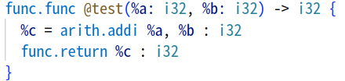
MLIR: Multi-Level Intermediate Representation
Supports multi-level, extensible IR, suitable for DSL and accelerator compilation
Dialect is the core design unit
A set of related Operations
Types
Attributes
Lowering implementation
Common MLIR Dialects:
arith — arithmetic operations; scf — structured control flow; triton
Dialects used by the Triton compiler
Triton — tensor operations, block-level abstraction →TritonGPU — GPU parallelism, layout, memory hierarchy →LLVM — low-level operations, close to machine code
result
attribute
operand

Slide 15
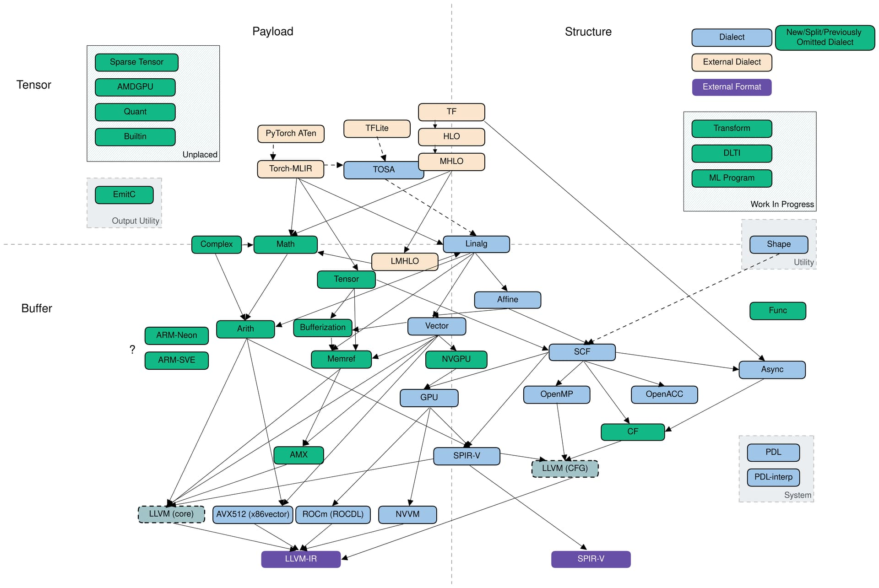
MLIR: Multi-Level Intermediate Representation
Supports conversions between dialects, allowing users to focus only on the optimization and lowering logic at the current level

Slide 16
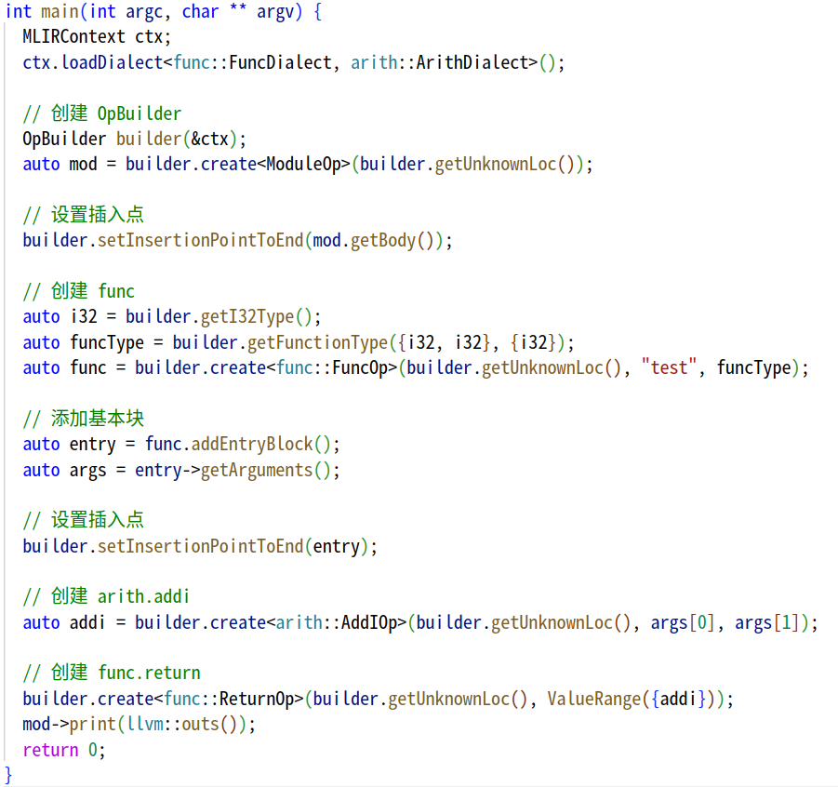
MLIR: CodeGen
Create OpBuilder
All Op can Only be Created by Builder
MLIR will manage some internal types
Build Type by builder.getXXXType
Or XXXType::get
Set InsertionPoint in builder
To fill the Block

Slide 17
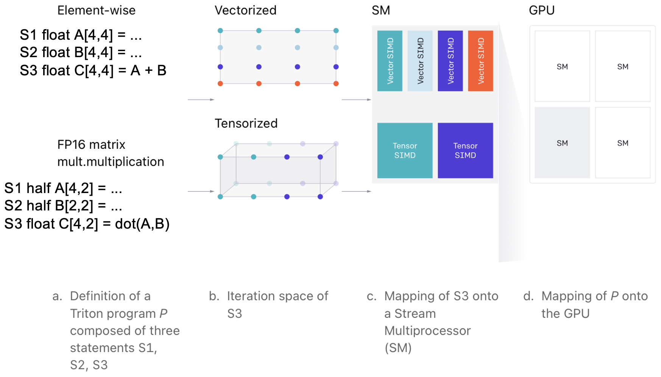
Triton and MLIR
Dialect->Triton IR->LLVM IR->PTX
Triton Automatic Parallelism by SM and by Instance
@jit
def add(X, Y, Z, N):
pid = program_id(0)
idx= pid * 512 + arange(512)
mask = idx < N
x = load(X + idx, mask=mask)
y = load(Y + idx, mask=mask)
store(Z + idx, x + y, mask=mask)
visible .entry add(
.param .u64 add_param_0, .param .u64 add_param_1,
.param .u64 add_param_2, .param .u32 add_param_3
)
.maxntid 128, 1, 1
{
.reg .pred %p<4>;
.reg .b32 %r<18>;
.reg .b64 %rd<8>;
ld.param.u64 %rd4, [add_param_0];
ld.param.u64 %rd5, [add_param_1];
mov.u32 %r13, %tid.x;
ld.param.u32 %r14, [add_param_3];
shl.b32 %r15, %r13, 2;
mov.u32 %r16, %ctaid.x;
mad.lo.s32 %r17, %r16, 512, %r15;
setp.ge.s32 %p3, %r17, %r14;
setp.lt.s32 %p1, %r17, %r14;
mul.wide.s32 %rd7, %r17, 4;
add.s64 %rd2, %rd4, %rd7;
@%p1 ld.global.cg.v4.b32 {%r5,%r6,%r7,%r8}, [ %rd2 + 0];
add.s64 %rd3, %rd5, %rd7;
@%p1 ld.global.cg.v4.b32 {%r9,%r10,%r11,%r12}, [ %rd3 + 0];
@%p3 bra LBB0_2;
ld.param.u64 %rd6, [add_param_2];
add.s64 %rd1, %rd6, %rd7;
add.s32 %r1, %r5, %r9;
add.s32 %r2, %r6, %r10;
add.s32 %r3, %r7, %r11;
add.s32 %r4, %r8, %r12;
st.global.v4.u32 [%rd1], {%r1, %r2, %r3, %r4};
LBB0_2:
ret;
}
def void add(i32* X .aligned(16) , i32* Y .aligned(16) , i32* Z .aligned(16) , i32 N .multipleof(2) ) {
entry:
%0 = get_program_id[0] i32;
%1 = mul i32 %0, 512;
%3 = make_range[0 : 512] i32<512>;
%4 = splat i32<512> %1;
%6 = add i32<512> %4, %3;
%9 = splat i32<512> N;
%11 = icmp_slt i1<512> %6, %9;
%14 = splat i32*<512> X;
%16 = getelementptr i32*<512> %14, %6;
%19 = broadcast i1<512> %11;
%21 = splat i32<512> undef;
%22 = masked_load i32<512> %16, %19, %21;
%26 = splat i32*<512> Y;
%28 = getelementptr i32*<512> %26, %6;
%31 = broadcast i1<512> %11;
%33 = splat i32<512> undef;
%34 = masked_load i32<512> %28, %31, %33;
%38 = splat i32*<512> Z;
%40 = getelementptr i32*<512> %38, %6;
%43 = add i32<512> %22, %34;
%46 = broadcast i32<512> %43;
%48 = broadcast i1<512> %11;
masked_store void %40, %46, %48;
ret void;}

Slide 18
Triton Dialects
Most Triton dialects inherits from MLIR native dialects
Arith: addf, addi, constant, cmpf, cmpi, ...
Math: exp, sin, cos, log, absi, absf, sqrt
StructuredControlFlow: for, if, while, yield, condition
Reduce effort to LLVM
Leverage LLVM optimizer for nvcc-like optimization after lowring to LLVM
TTIR: From python AST
Tensor operation abstraction
Block-level parallelism representation
module {
tt.func @add_kernel(%arg0: !tt.ptr<f32>,
%arg1: !tt.ptr<f32>,
%arg2: !tt.ptr<f32>,
%arg3: i32) {
%c1024 = arith.constant 1024 : i32
%pid = tt.get_program_id x : i32
%offset = arith.muli %pid, %c1024 : i32
%range = tt.make_range {end = 1024, start = 0} : tensor<1024xi32>
%offsets = arith.addi %offset_splat, %range : tensor<1024xi32>
// 加载
%x = tt.load %ptr_x : tensor<1024x!tt.ptr<f32>>
%y = tt.load %ptr_y : tensor<1024x!tt.ptr<f32>>
// 计算
%z = arith.addf %x, %y : tensor<1024xf32>
// 存储
tt.store %ptr_z, %z : tensor<1024x!tt.ptr<f32>>
tt.return}}

Slide 19
Triton Dialect
TritonGPU IR（TTGIR）
Add layout information
Incorporate hardware target and warp configuration
NVIDIA PTX
Virtual instruction set for NVIDIA GPUs
Platform-independent intermediate representation
Compiled into actual machine code by ptxas (Streaming ASSembler)
PTX Instruction Examples
#blocked = #triton_gpu.blocked<{
sizePerThread = [4],
threadsPerWarp = [32],
warpsPerCTA = [4],
order = [0]
}> module attributes {
"triton_gpu.num-warps" = 4 : i32,
triton_gpu.target = "cuda:80" // Ampere
} {
tt.func @add_kernel(...) {
// 现在张量带有布局属性
%x = tt.load %ptr : tensor<1024x!tt.ptr<f32>, #blocked>
%y = tt.load %ptr : tensor<1024x!tt.ptr<f32>, #blocked>%z = arith.addf %x, %y : tensor<1024xf32, #blocked>
}
}
wmma.mma.sync.aligned.m16n16k16.row.col.f32.f32
{%d0, %d1, %d2, %d3, %d4, %d5, %d6, %d7},
{%a0, %a1, %a2, %a3, %a4, %a5, %a6, %a7},
{%b0, %b1, %b2, %b3, %b4, %b5, %b6, %b7},
{%c0, %c1, %c2, %c3, %c4, %c5, %c6, %c7};

Slide 20
Other GPU Backend
AMD
LLVM IR
AMDGPUISelDAGToDAG
SIInstrInfo
GCNRegisterInfo
GCN/CDNA Assembly
llvm-mc/ROCM
AMD GPU Binary (ELF)
AMD Matrix Core: Like Tensorcore
No Significant Difference at TritonIR
Intel
MLIR SPIR-V Dialects
spirv.Load, spirv.Store
spirv.GroupOperation (SIMD)
spirv.CooperativeMatrix (XMX)
SPIR-V Binary
Intel Graphics Compiler - IGC
Gen ISA Binary (ELF)
Special SPIR-V extentions

Slide 21
Cross-Backend Code Generation Challenges
Execution Model Difference
NVIDIA: Warp = 32 threads, lockstep execution
AMD: Wave = 64 threads (CDNA), or 32 (RDNA)
Intel: SIMD width editable(8/16/32)
Abstracted as an "execution width" parameter at the TritonGPU IR level
Memory Hierarchy Difference
NVIDIA: Shared Memory (explicitly managed)
AMD: LDS (similar, but different size/bank count)
Intel: SLM (Shared Local Memory, smaller)
Shared memory abstraction + backend-specific size configuration
Differences in Matrix Acceleration Units
NVIDIA: Tensor Core (mma.sync, wgmma)
AMD: Matrix Core (v_mfma_*)
Intel: XMX (dpas, joint_matrix)
tt.dot unified interface, backend maps to specific instructions
class NVIDIABackend(Backend):
def get_wave_size(self): return 32
def lower_dot(self, op):
if self.capability >= 90:
return emit_wgmma(op)
else:
return emit_mma(op)

Slide 22
Code Generation Optimizations
Vectorization
Scalar version
Vector version
Vectorization in Triton
Loop Unrolling
Reduce loop overhead (branches, counters)
Expose more instruction-level parallelism
Better register reuse
for i in range(N):
c[i] = a[i] + b[i]
for i in range(0, N, 4):
c[i:i+4] = a[i:i+4] + b[i:i+4]
for k in range(0, K, 16):
acc = dot(a[k:k+16], b[k:k+16], acc)
@triton.jit
def kernel(ptr, N, BLOCK: tl.constexpr):
offs = tl.arange(0, BLOCK) # Generate vector index
# Triton select vector size automatically
# based on BLOCK size and data type
x = tl.load(ptr + offs)
# Compile as vector oprtation
for k in range(0, K, 64):
acc = dot(a[k:k+16], b[k:k+16], acc)
acc = dot(a[k+16:k+32], b[k+16:k+32], acc)
acc = dot(a[k+32:k+48], b[k+32:k+48], acc)
acc = dot(a[k+48:k+64], b[k+48:k+64], acc)

Slide 23
Group Discussion: How does Triton support different NVIDIA architectures?

Slide 24

The Solution: FlagOS, a Unified AI Software Stack

Slide 25








https://space.bilibili.com/3546791834290849
https://github.com/flagos-ai
https://www.zhihu.com/people/95-22-20-18/posts
https://flagos.io/Home

Slide 26

Thanks for your time！

